Slide 1
Geographical Concepts
In Year 7 language!

Slide 2
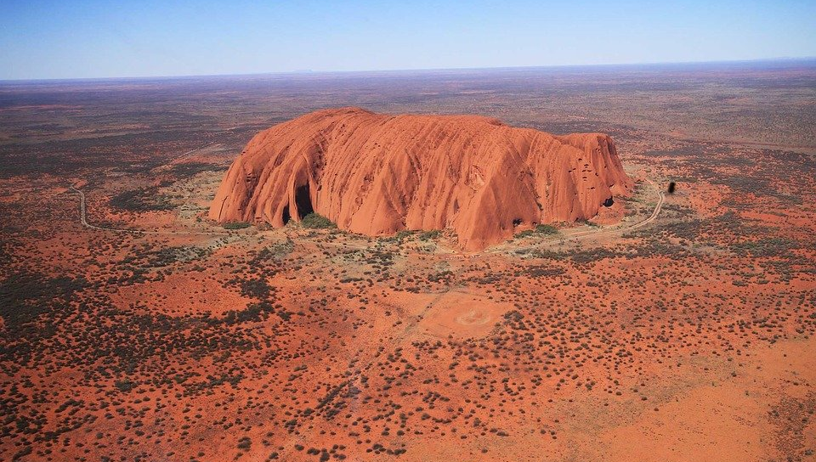
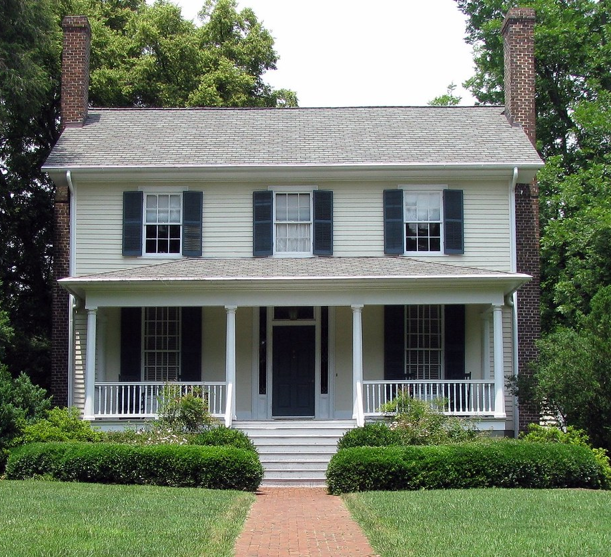
Place
The importance of parts of the Earth’s surface and what these places are like.
e.g. Your house, Uluru,
Australia
This Photo by Unknown Author is licensed under CC BY

Slide 3
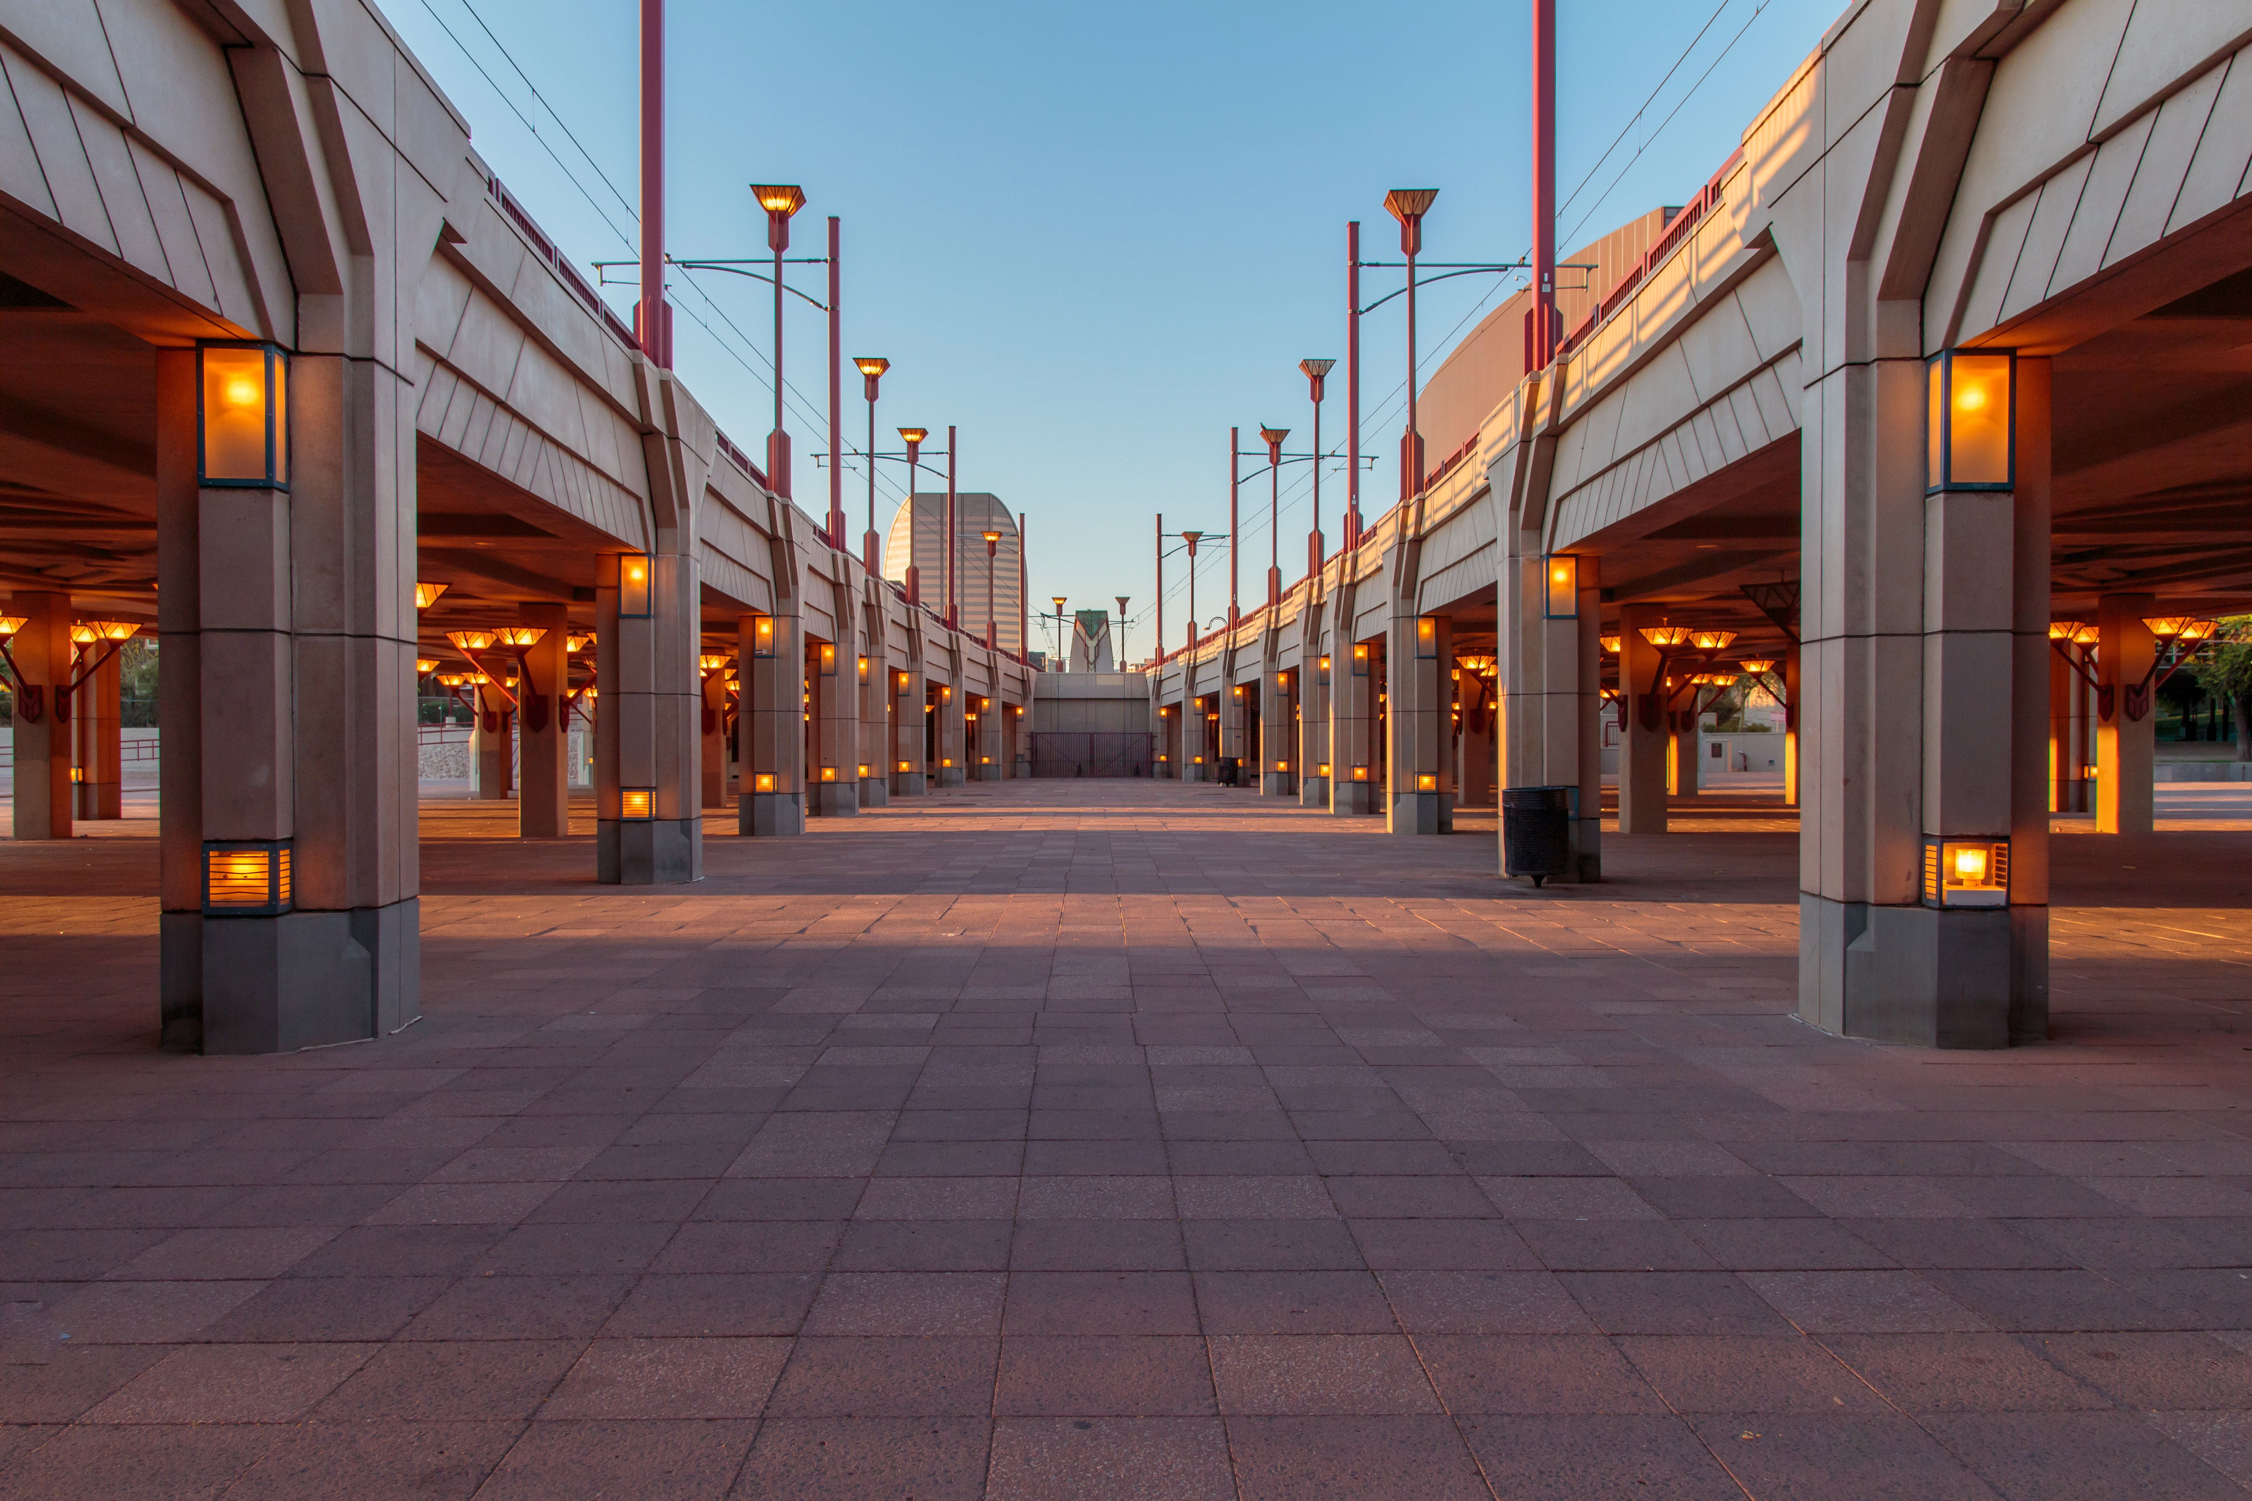
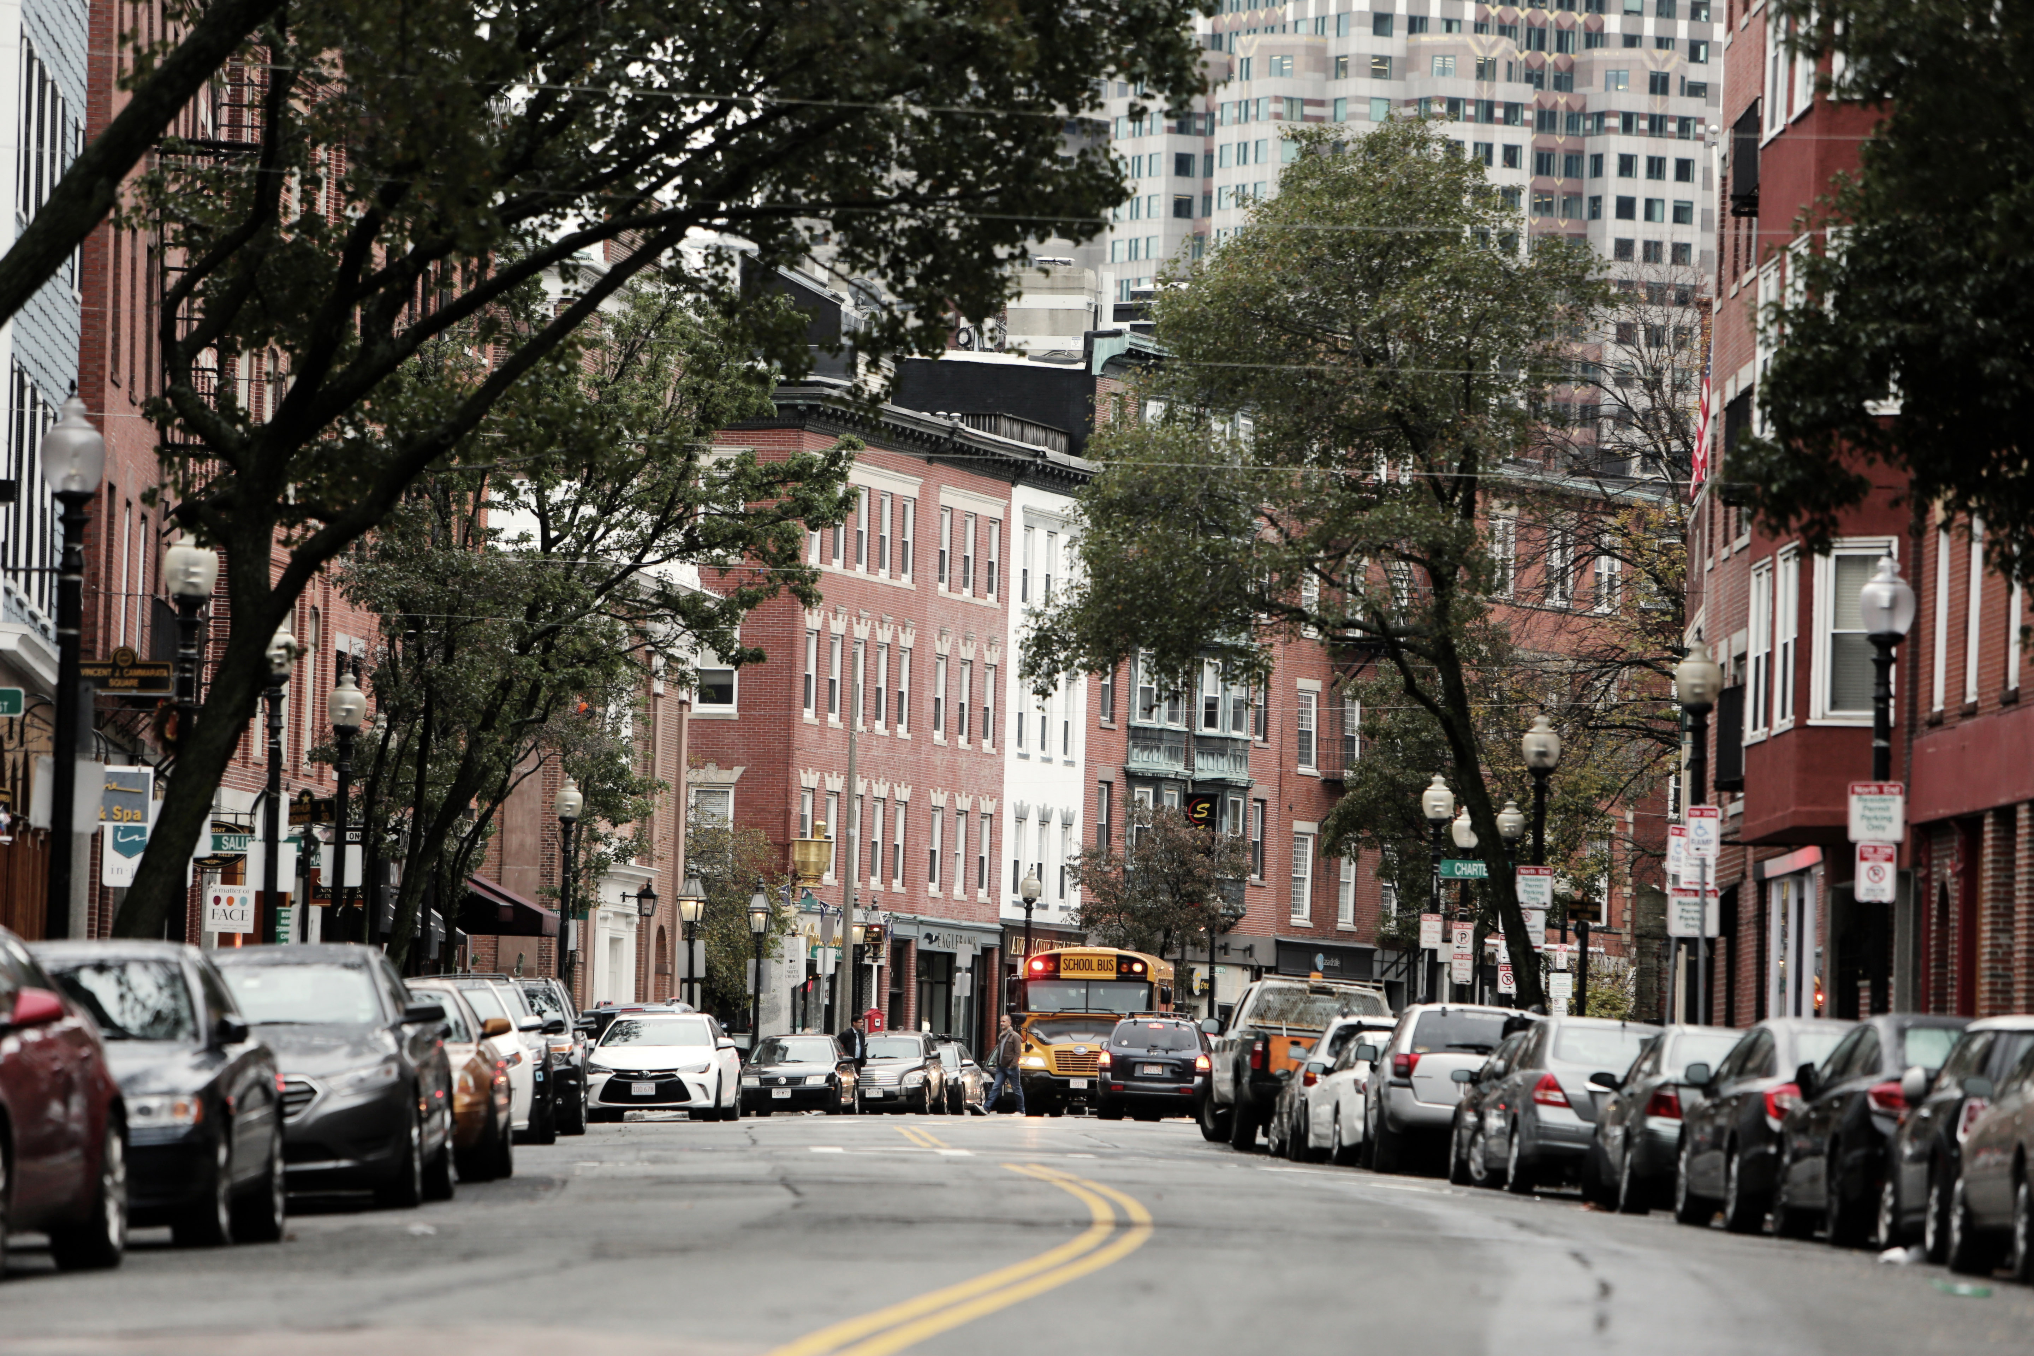
Space
The importance of location and organisation of the spaces where we live and the patterns of development.
e.g. Why are some suburbs more popular/expensive than others?

Slide 4
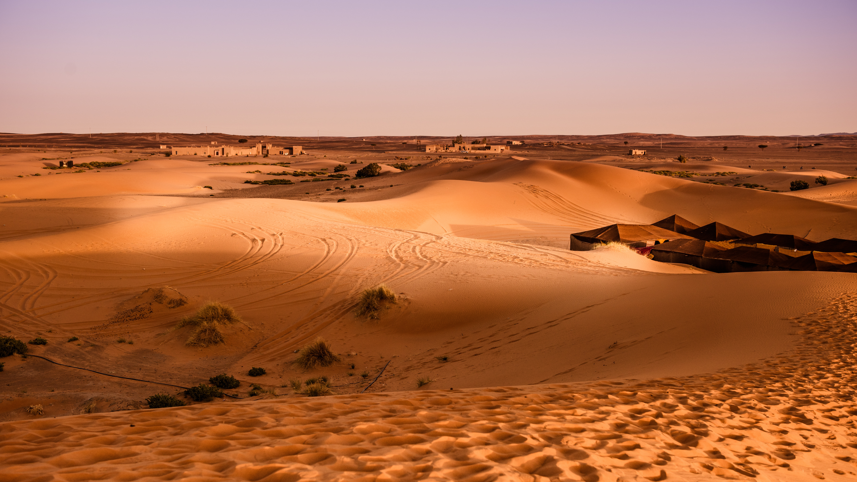
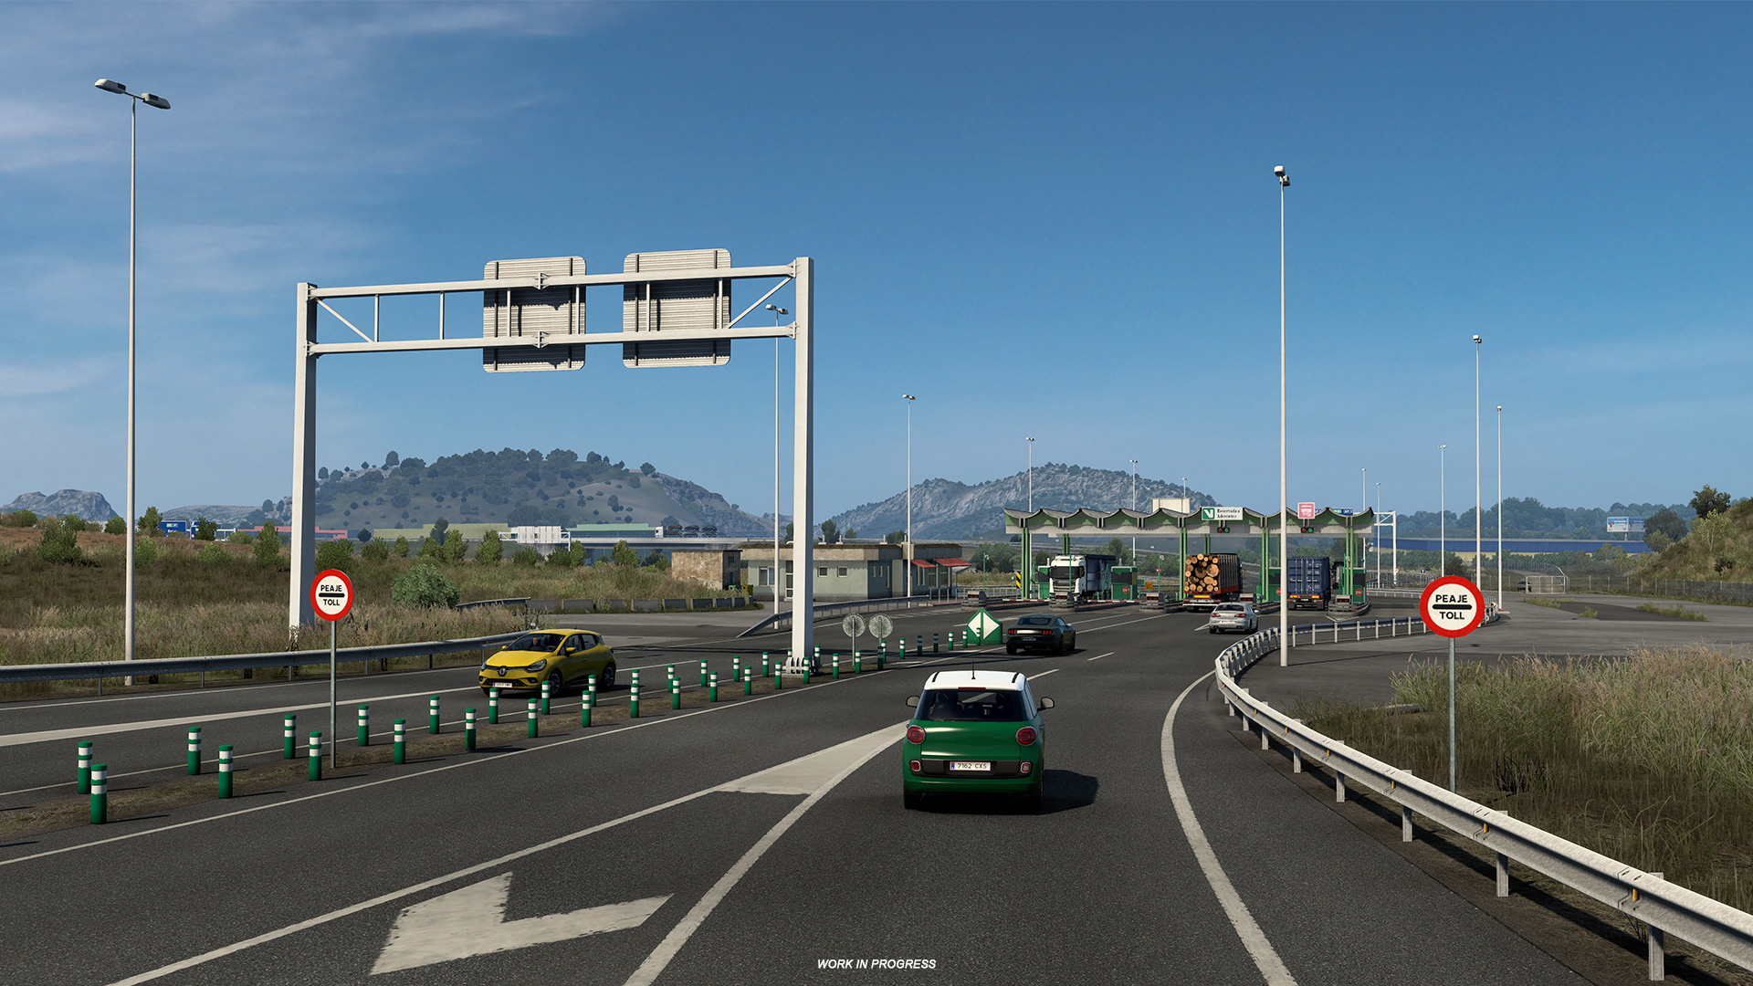
Environment
The natural and man-made areas of the Earth that have special characteristics.
eg Desert – little rain, little vegetation , freeways for cars and trucks
This Photo by Unknown Author is licensed under CC BY

Slide 5
Interconnection
The ways that human and natural environments affect each other.
e.g. Our plastic pollution can enter marine environments, kill marine life which impacts on the marine ecosystem and food for humans.
This Photo by Unknown Author is licensed under CC BY-NC-ND

Slide 6
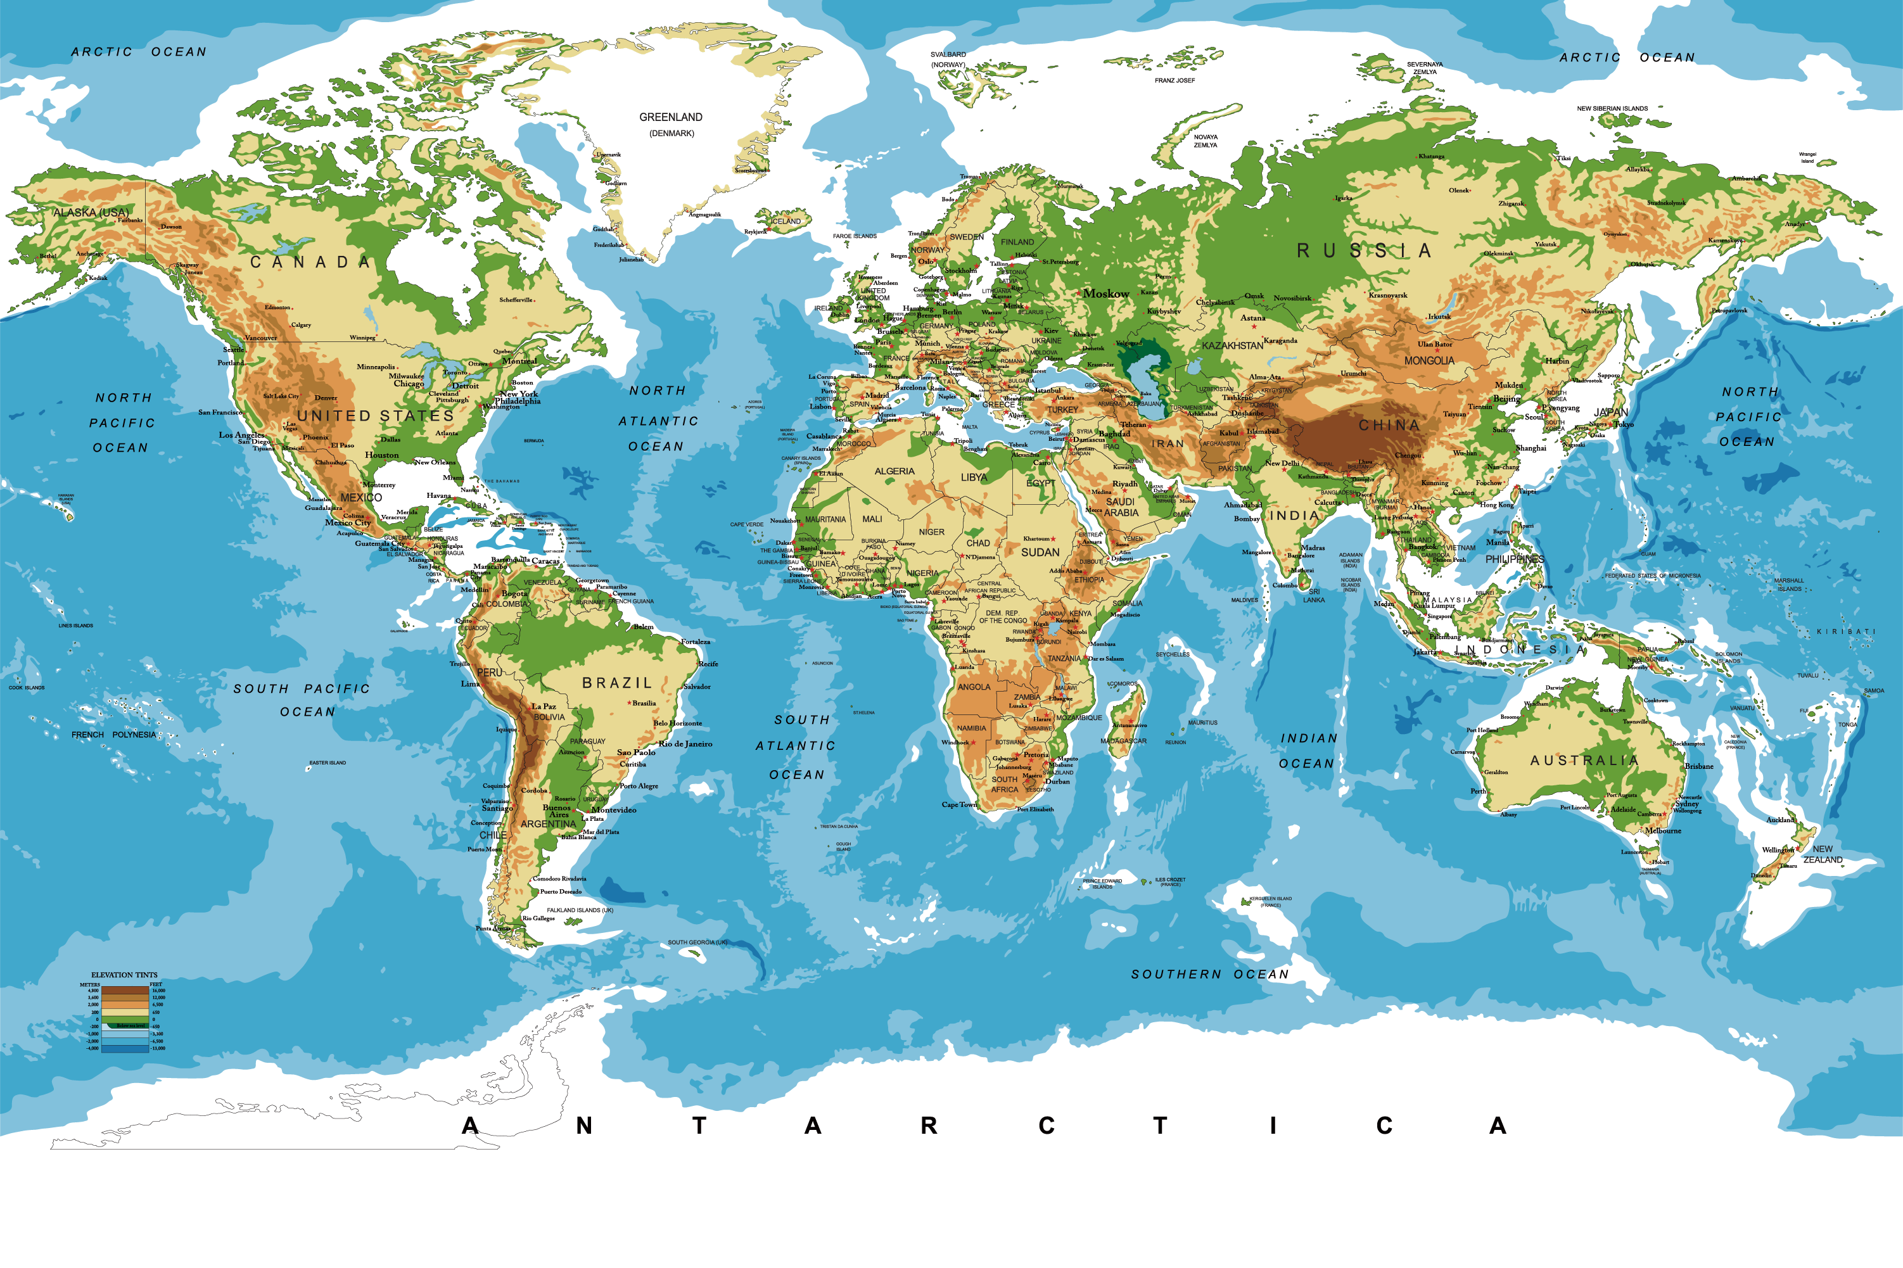
Scale
Scale can be used to describe the relationship between a distance on a map and the actual distance on the ground – 1:1,000,000 (1mm = 1 km)
Scale can also be used to describe different spatial levels – local scale, national scale, global scale.
This Photo by Unknown Author is licensed under CC BY-SA
This Photo by Unknown Author is licensed under CC BY-NC

Slide 7
Sustainability
The management and use of resources to support us and future generations.
e.g. use of solar power which will never run out instead of coal powered electricity that has a limited future
This Photo by Unknown Author is licensed under CC BY

Slide 8
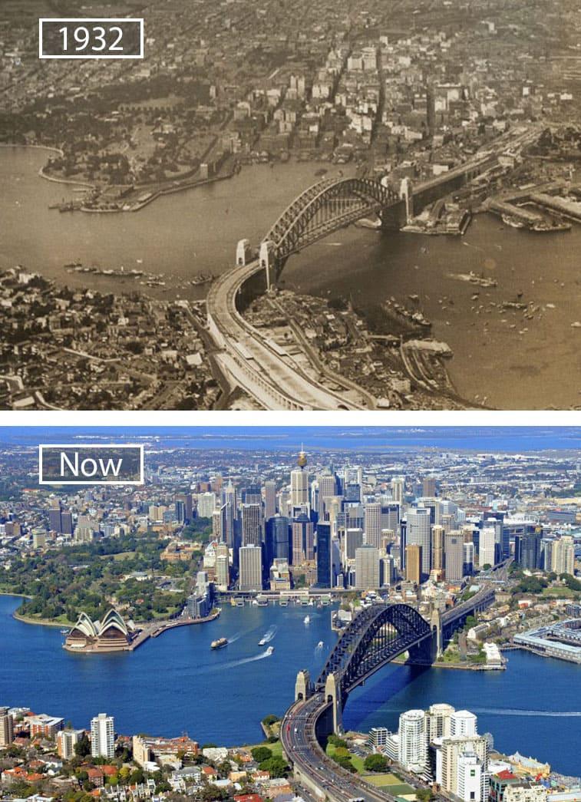
Change
How things have developed over time.
\
eg. areas around Pakenham used to be used for farming – now it is full of houses.

