Slide 1
Geography Mapping Skills

Slide 2
How many continents are there? Let’s vote!
1 | 2 | 3 | 4 | 5 | 6 | 7 | 8 | 9 | 10
What makes a continent a continent?
https://www.youtube.com/watch?v=3uBcq1x7P34

Slide 3
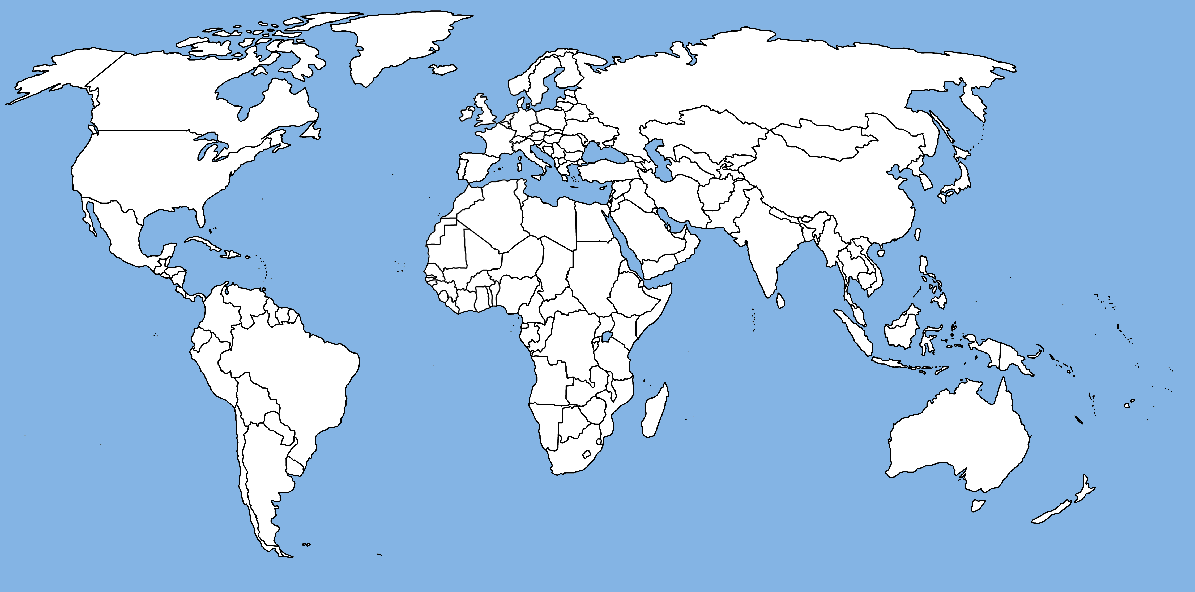
Let’s see what we remember

Slide 4
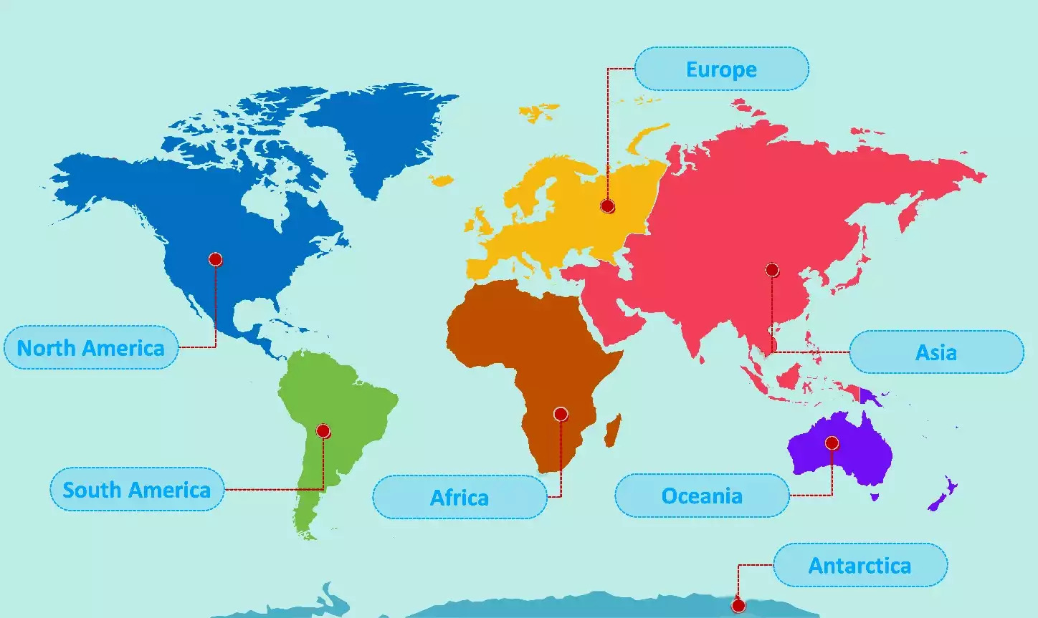
7 Continents

Slide 5
Are there more oceans than continents?

Slide 6
Features of a Map
BOLTSS
https://www.youtube.com/watch?v=cZUtOZqpBBI
Notes:
Find textbook

Slide 7
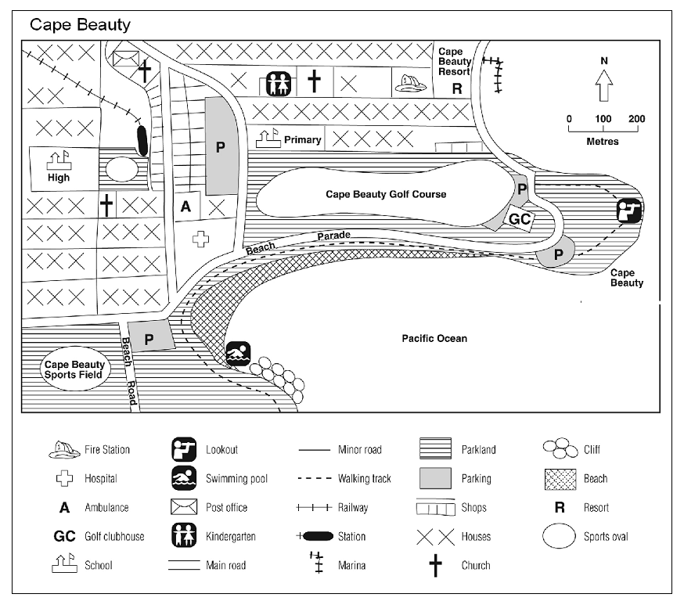
BORDER
This is the outline or the box that encloses the whole map.
Use a fine liner.

Slide 8
ORIENTATION
Usually a North arrow facing up, showing the direction.

Slide 9
LEGEND
List that explains what each colour, symbol and pattern on the map stands for.
Always use a ruler.

Slide 10
TITLE
Heading that describes the map and what it is showing.

Slide 11
SCALE
Marked line or ratio indicating the distance of the map in real life (usually located at the bottom of the page)

Slide 12
SOURCE
Where possible, indicate where you got the information from to draw the map.
Eg. GoogleMaps, Jacaranda Atlas

Slide 13
What BOLTSS are missing on this map?

Slide 14
Your Task: Create your own map of the world
On a blank map of the world carefully colour each continent a different colour.
Draw a legend/key with a ruler to show what continent each colour represents (example shown below)
Europe

Slide 15
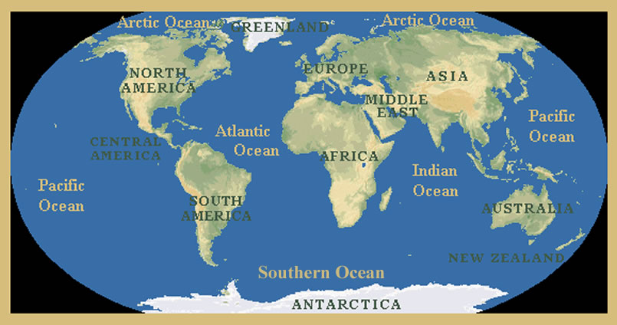
Your Task: Create your own map of the world
Add the oceans neatly to your map of the world.

Slide 16
Types of Maps
Geographers use different maps for different purposes.
These include :
Topographic maps
Thematic maps
Weather maps
Street maps
Satellite maps
Political maps
Physical maps

Slide 17
Types of Maps
This clip provides some further examples of types of maps
https://www.youtube.com/watch?v=tY1_KR4uJUc

Slide 18
Topographic maps
A topographic map and shows a small area of the earth’s surface in great detail.
It shows the shape of the land (topography) as well as different types of natural features (such as rivers and vegetation) and cultural features (such as land use, settlement patterns and road and rail networks).
Topographic maps use a variety of symbols to represent these features.

Slide 19
Thematic maps
Thematic maps are often used to show the distribution of one or more of the following:
climate, vegetation types, average rainfall, average temperature, population density, various development indicators (for example, population growth rates) and agricultural land uses.
A thematic map showing the Population of elderly people in Australia. Thematic maps that use a colour scale or shading to show a pattern are called choropleth maps.

Slide 20
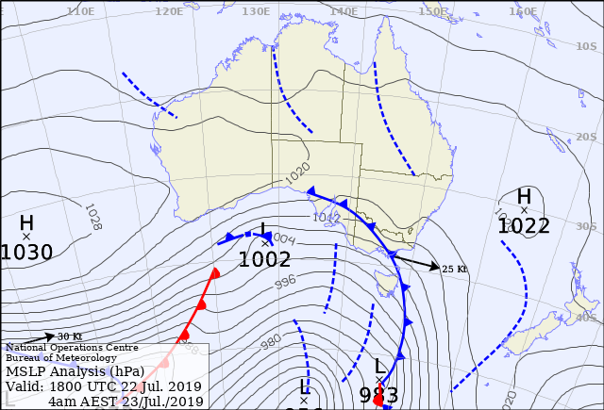
Weather maps
Weather maps (synoptic charts) show weather conditions over particular areas of the earth’s surface at a particular time.
You also see the location and direction of warm and cold fronts. From this information, forecasts about the weather can be made several days ahead.

Slide 21
Street maps
Street maps show parts of a city or town. Streets are named and important features are shown. These features include schools, police stations, religious buildings, shopping centres, parks and major landmarks.
The larger the scale of the map, the greater the variety of information that can be shown. Grid lines are drawn over street maps so that the location of features can be easily recorded and found.

Slide 22
Longitude and Latitude
This clip introduces latitude and longitude
https://www.youtube.com/watch?v=swKBi6hHHMA
Latitude - East to West
Longitude – North to South

