Slide 1
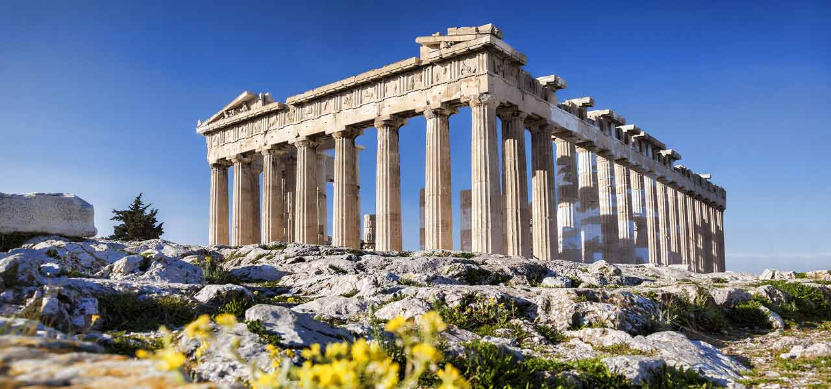
See, think, wonder……..
Notes:
This is the Parthenon on the Acropolis . The Parthenon was a symbol of Athenian wealth, political and cultural power in Greece in the middle of the fifth century. It was larger and more opulent than any temple that had been constructed on the Greek mainland before.

Slide 2
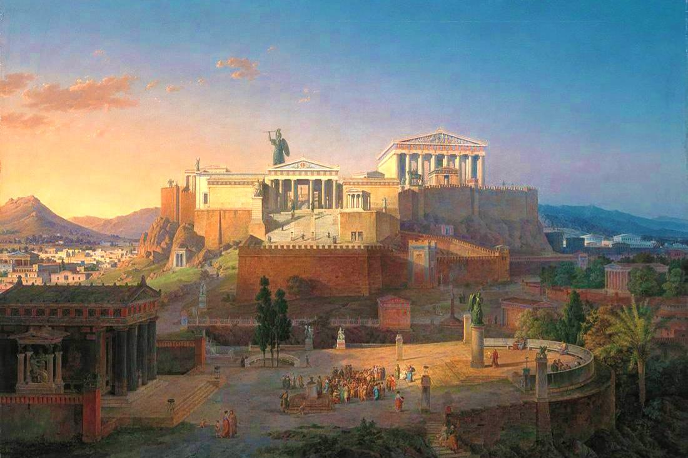
Ancient Greece

Slide 4
Ancient Greece
Said to be the birthplace of Western Civilisation and Democracy.
About 2500 years ago, the Greeks created a way of life that other people admired and copied.

Slide 5
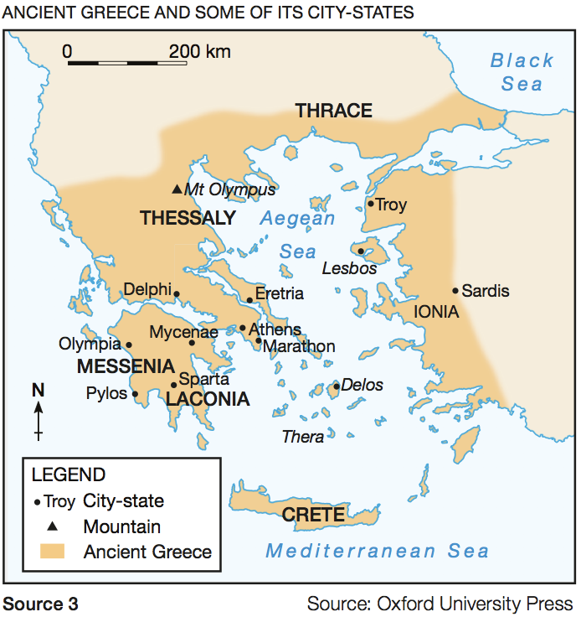
What do you see?

Slide 6
Geography of Ancient Greece
Surrounded the Aegean Sea (see previous slide).
Included the many islands in the Mediterranean and Aegean seas.
Greece’s mountainous mainland and mostly unnavigable rivers made travelling difficult.
These geographical features had a significant influence on the development of ancient Greek societies and civilisations.
Geography & Early Greece www.youtube.com/watch?v=5FVpL4ma8nQ (10m stop at 5.11)
Mr Corwin

Slide 7
City States (or Polis)
City-states were independent urban centres that generally shared a common language and religious beliefs.
Occasionally, some banded together to fight a war or for protection. Now and then, one might dominate for a time.
The most powerful city-states were Athens and Sparta. They were also at times bitter rivals.

Slide 8
Sailors & Pirates
It was much easier to travel to different parts of Greece by sea than by land.
Ancient Greeks became skilled sailors and travelled the Mediterranean Sea for trade and to set up colonies.
Some early Greeks made their living as pirates.
Athens became a powerful empire with many ships and sailors.

Slide 9
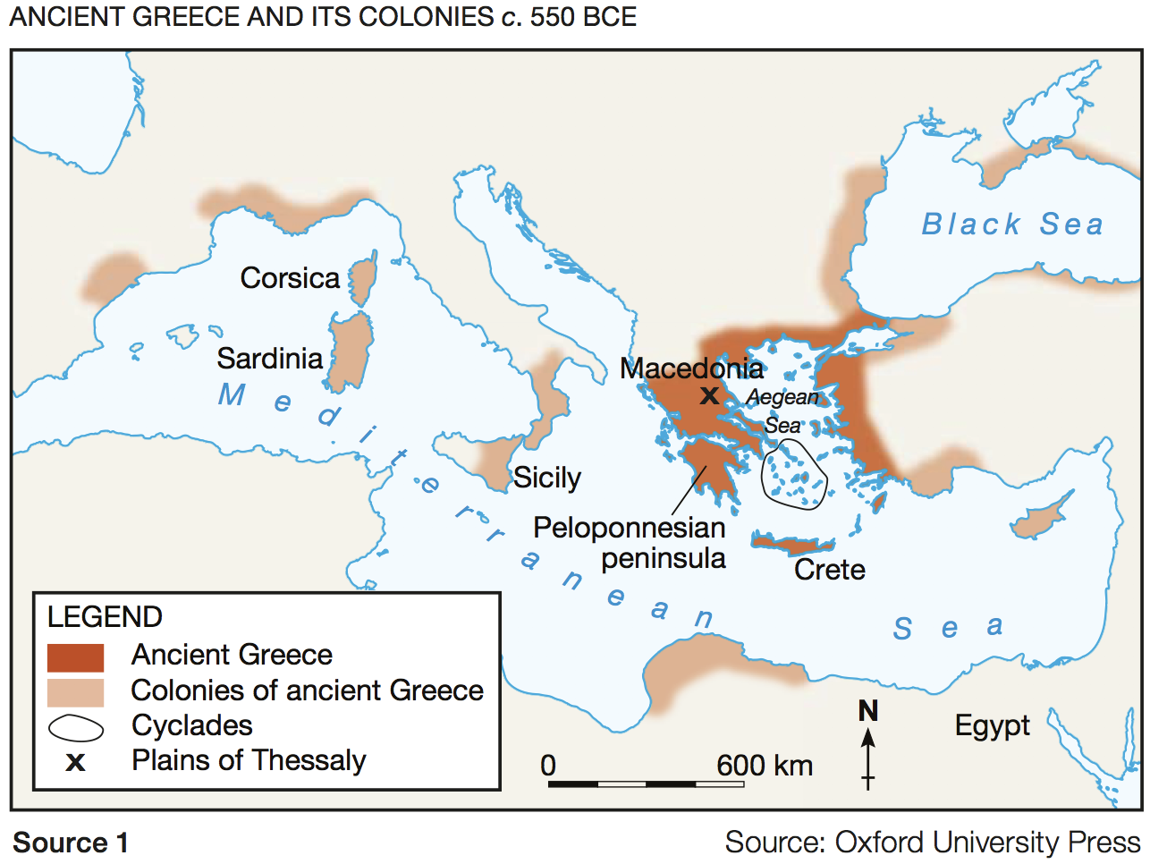

Slide 10
Trade
Trade was important to the Greeks as they did not have access to resources such as metals and timber.
Hot and dry weather meant it was not possible to grow a variety of foods.
Grapes, olives and grains were the main foods that could be grown.

Slide 11
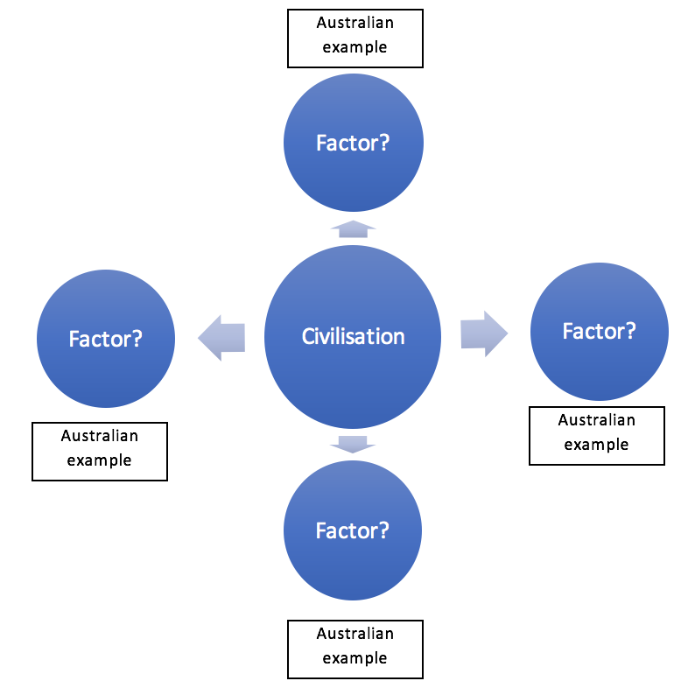
What makes a civilisation?
Partner task:
As a class read: An Overview of the Ancient World , Macmillan History 7, Ch 2, p. 64-68. Read the red sub headings sections What are some of the common features of Ancient Civilisations.
Draw a mind map showing the factors that contribute to make a civilised society.
Then give an example of each factor as we see in Australia.
Notes:
Red subheadings start on page 64 till 68. They include Common Features of Ancient Civilisations , Access to water, Specialisation in trades and professions , structure and Hierarchy, Writing , Trade and Warfare , Monumental architecture, Laws and Regulations.

Slide 12
Who’s in charge?
Now and then, and then!
Find out about who ran the city-states of Athens and Sparta, and compare them with Australia today:
Resources:
Ancient Greece Pearson History NSW 7, p. 94-97
Video: https://www.youtube.com/watch?v=euZh8KLB5eE (5.42)
 | SPARTA | ATHENS | AUSTRALIA
Who is in charge?
Who chooses the leader/s and how?
How can they be removed?
Who has no say at all?

Slide 13
Democracy
How did democracy come about in Athens?
http://ed.ted.com/lessons/what-did-democracy-really-mean-in-athens-melissa-schwartzberg
Fierce Warriors of Sparta
http://ed.ted.com/lessons/this-is-sparta-fierce-warriors-of-the-ancient-world-craig-zimmer

Slide 14
Life in Ancient Greece
In pairs, create a mind map about everyday life in Sparta and Athens for the following people:
Boys
Girls
Men
Women
Foreigners / non-citizens
Slaves
One person can research Athens, the other Sparta.
Together, you can then compare with life in Australia today.

Slide 15
Venn diagram- summarise similarities and differences

Slide 16
Which culture do you believe have the most clearly developed civilisation according to a series of factors

Slide 17
FACTORS to consider
Architecture and Infrastructure;
Trade;
Military and Warfare;
Trades and Professions;
Writing;
Well Developed Laws;
Structure and Hierarchy

